Slide 1


DOUG’s DOUG TALK
Here is the Subtitle that is witty, clear, memorable, and roles off the tongue nicely with a diminutive amount of syllables and begs the recipient to know what’s next:
“A Ride on the Privately Chartered Office Space Ship”
Want me to present this to you? I will.
AWESOME PRESENTATION

Slide 2
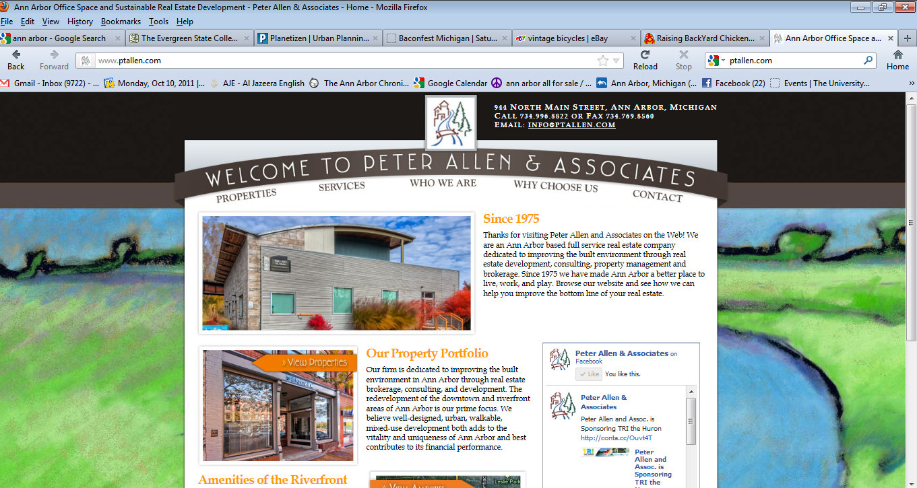

Slide 3

Getting out of here?
  Before you move identify and weigh:
    Location
    Image
    Rent
    Size
    Layout
    Occupancy Date
    Special requirements
    Term of Lease

Slide 4
First Rule of….
Clip Art usually sucks in powerpoints

Slide 5
Stages of a Commercial Real Estate Deal
“Never leave the work of tmrw that you can do today, if you can do it the day after tmrw” – Stoyan
Find locations you like via google, drive/walk bys, networking, broker’s help
Call Owner or Broker
View Properties, all in one day, take notes and pictures
Select two or three based on critical likes and dislikes
Present Letter of Intent to all three, or ask for one
Make Deals Apples to Apples, look at Gross lease vs. Modified gross vs. NNN lease
Confirm ALL details (i.e. well…where is the parking…who controls the temp?...what happens to the taxes if you sell the building?)
Sign an LOI
Do your Due Diligence (Zoning, COR, internet speeds, etc.)
Receive lease
Consult Legal
Sign lease, get keys, order furniture, utils.
Have a Party, make sure you invite me

Slide 6
Real Estate Deduction Theorem
Deduce everything to $/SF/FTE
To Solve for Total SF Needed: (# of FTE’s x 150 SF = T#SF
To Solve for Total Rent Per Month: T#SF x $/SF = $/Yr.
To solve for Total $/SF per FTE: $/Yr. / T#SF / #FTE’s
Example: 10 FTE’s x 150 SF for each FTE + future growth (500/sf) = 2000 SF
You’re bringing in $200,000K/yr. in sales, so take 15% to spend on rent. That’s $30,000 you can spend on rent a year. Divide that by 2000SF =
$15/SF or $2,250 a yr. per FTE

Slide 7
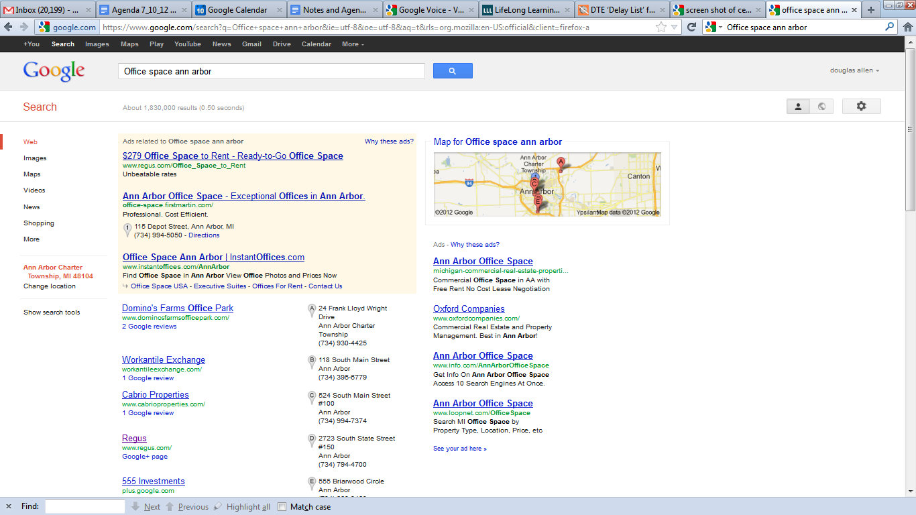
Widescreen Graphics
Even a single graphic, such as a chart, can be presented more dramatically in widescreen.
Notes:
First is to get out of the house and café’s

Slide 8
CFO…Where is our house? HR...Where is our home?
OPTION 1
OPTION 2
SUBURB OFFICE
2,500 SF (more room for growth)
New Construction, Lots of glass
Crappy shared entrance
Walk score: 50
Lease says tenant responsible for HVAC
Great signage (15K cars a day)
Close to CFO’s house
Owner drinks Diet Monster
$10/SF in TI + 5 months Free rent
Need to drive for everything but has parking
Lacks character and memerableness
Rental Rate:$15/SF/Year
MAIN STREET OFFICE
Total Space Available: 2,000 SF
Historic Bldg. with upgrades
$5/SF in TI, 2 months free rent
Walk score: 91
Owner brews his own beer
CFO hates parking in structures
Only building in town using geothermal energy
Noisy café underneath, super cute, but flaky wait staff, bomb macchiato
No elevator, no parking, alley stinks ☹
Heavy Cool Factor, original wood floors, no offices though, bathroom sucks, great view
3rd floor could be available in 2 years.
Rental Rate: $20 /SF/Year

Slide 9



How can you make this deal happen?
Move to a NEZ!
Remember you had about $30K/Yr. for rent for 15 people.
And you need about $40K/Yr.
You have $10K diff./yr.
Sign a longer lease
Ask for less buildout in hopes of cutting the rent
INCREASE REVENUE!!!!
Use more Clip Art
Use less space
Hire smaller people
Ask for reduced rent/Free rent
Cut salaries
Buy less furniture
Back load lease
Bring in more investors
Remember to add up ALL the terms of the deal, identify ALL the risks, add up all the years of the lease and then analyze that number against your happiness and productivity in the space.

Slide 10
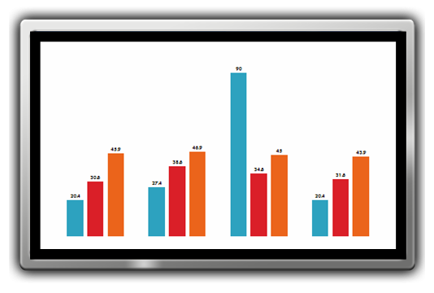
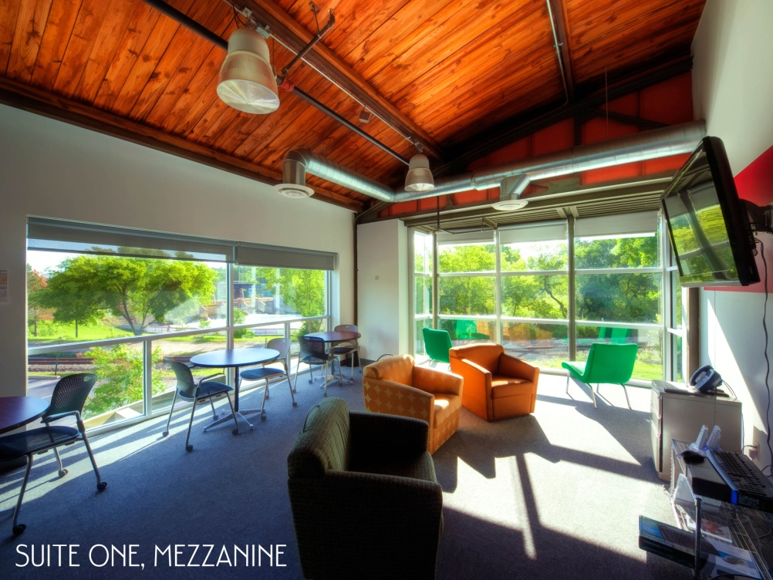
The case for EE and Healthy Interiors
  Triple Bottom Line: Environment, Society, and Economy
  Non-Toxic interiors = Higher Productivity
  Lower energy Bills = More $ for the business, bigger flat screens
  Use your office as a marketing piece

Slide 11
RE Myth 589: “All Landlords are Greedy”
  Landlords want ROI, just like you
  Landlords have lots of fixed costs & only one time to set the price
  Brokers can make or break a deal
  Use Real Estate consultants like me on an hourly basis for the first small office. Then use reps for larger spaces.
  Good landlords are your business partners
  Finally, Always have a good friend in real estate.

Slide 12

DOUGLAS LANE ALLEN,
VP of sales and leasing for
Peter Allen and Associates
944 N. Main, Argo Pond
douglas@ptallen.com
Mobile: 734.260.0857

